Slide 1
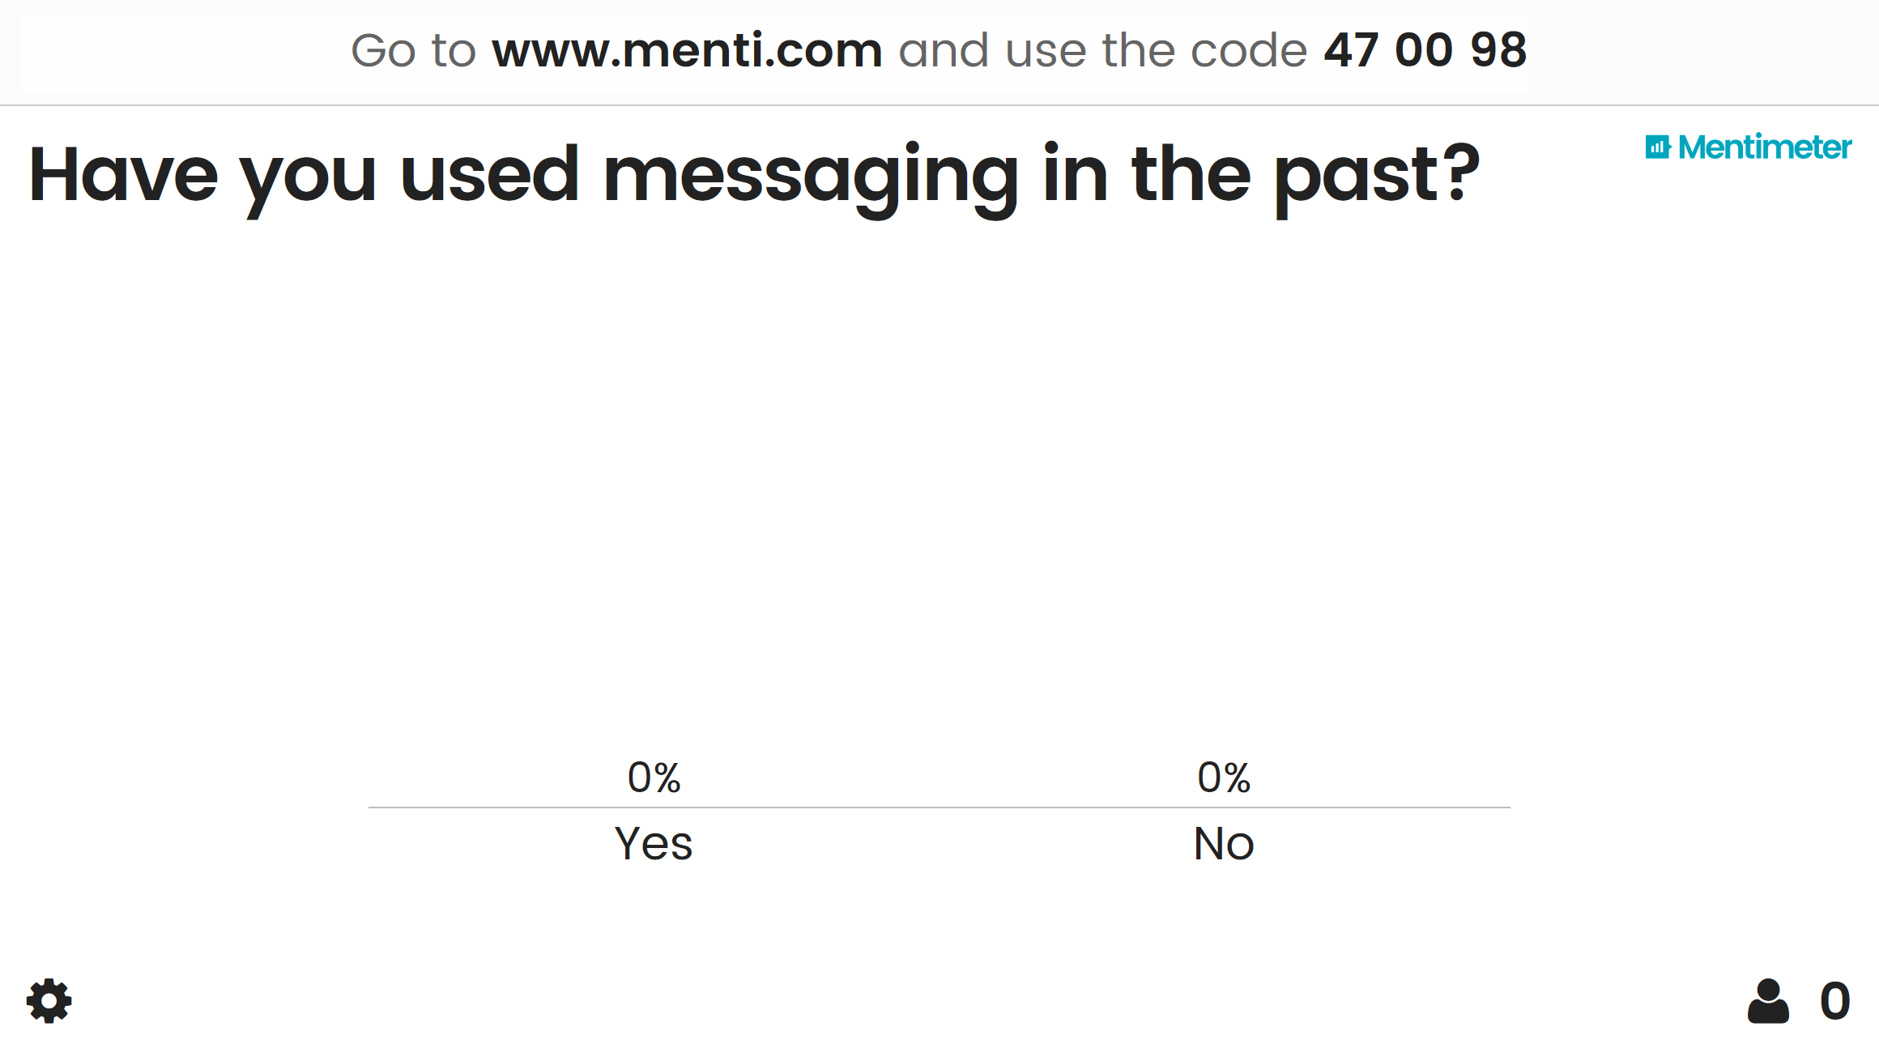

Slide 2

Azure Service Bus - The good, the Bad and the Awesome Sean Feldman, Azure Advisor & MVP
Sean Feldman
Notes:
4th oldest Azure service

Slide 3
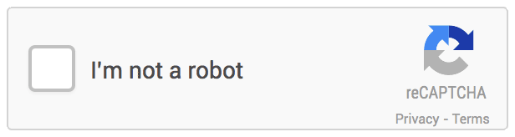
Disclaimer

Slide 4

Communication
Notes:
Why do we need messaging? Why can’t we build systems the way those where build in the past?
What’s wrong with layered architecture?
Temporal coupling – RPC / Synchronous communication (calls with assumptions that components are online at the same time)
Spacial coupling – knowing where components are located
Platform coupling – sending binary files vs Text based messages

Slide 5
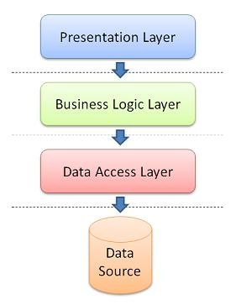

Slide 6
Example: Temporal Coupling
Service A
Service B
Place order
Register order
Result
Result

Slide 7
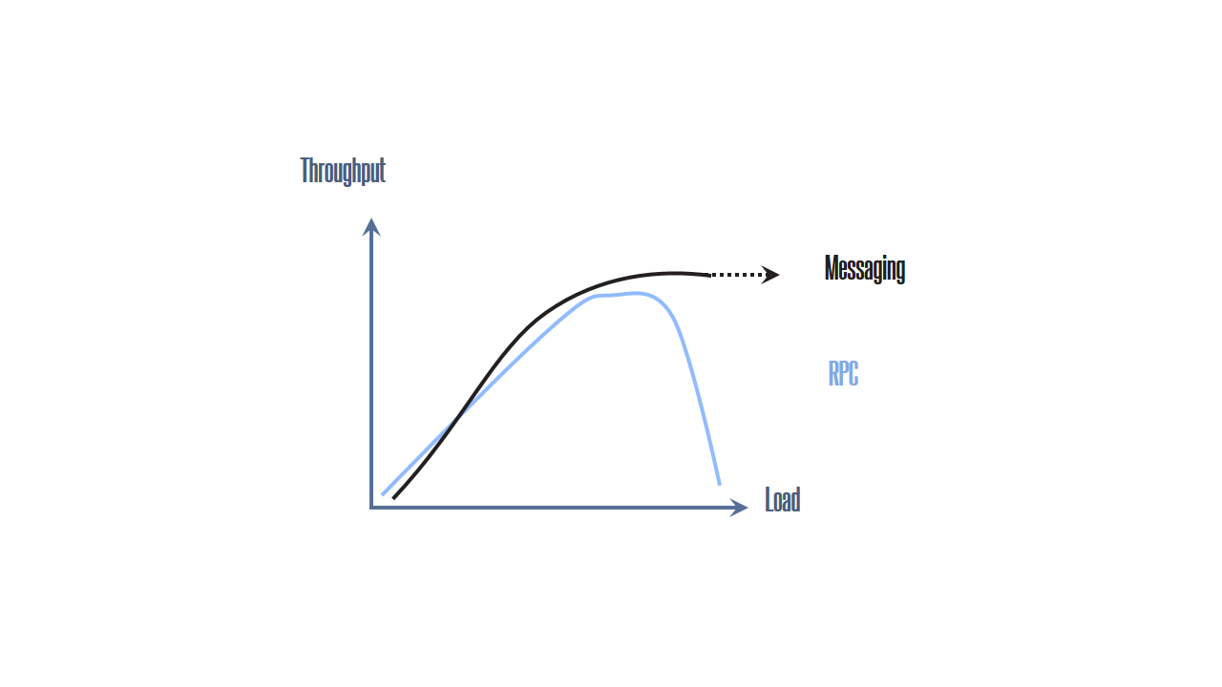
Performance RPC vs Messaging

Slide 8






Service provided by ASB
Brokered Messaging
EventHubs
Relays
Queues
Topics & Subscriptions
Notes:
Focus of this presentation is brokered messaging, not relayed messaging (Relays) or EventHubs

Slide 9
Some Stats
>275 Billion
Message operations on Azure Service Bus Messaging (Standard) per month
1.5 Million
Message Queues and Topics in Production
>35,000
Daily Active Service Bus Namespaces
440 Billion
1.8 Million
>80,000
>250 TB
Daily Data Volume
>12 PB
Monthly Data Volume
28 PB

Slide 10
ASB Options & Tiers
On-Premises Infra and IaaS
Private Cloud
Public Cloud (Standard)
Public Cloud (Premium)
Service Bus for Windows Server 1.1
Windows Azure Pack Service Bus for Windows Server 1.1
Microsoft Azure Service Bus (PaaS)
Microsoft Azure Service Bus (PaaS)
Consistent Capabilities
Azure Pack / Windows Server Update Cycle
Azure Update Cycle

Slide 11
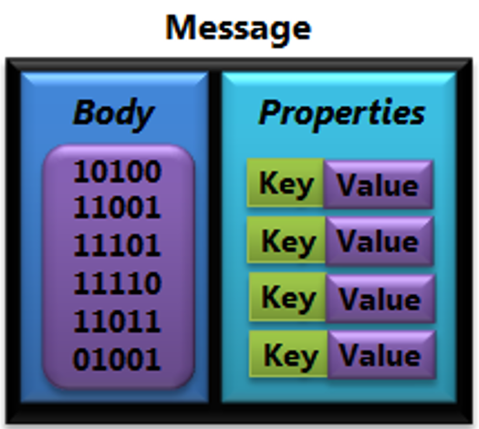
Brokered Message
Notes:
256KB vs 1MB
64KB headers for both tiers

Slide 12
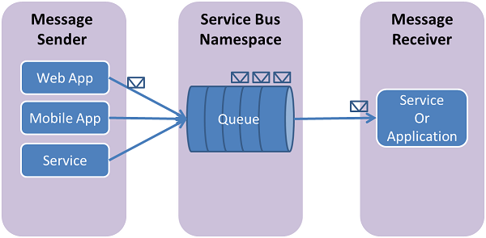
Queue

Slide 13
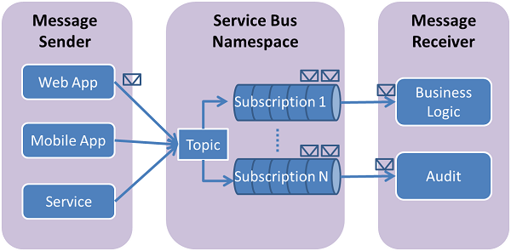
Topic

Slide 14
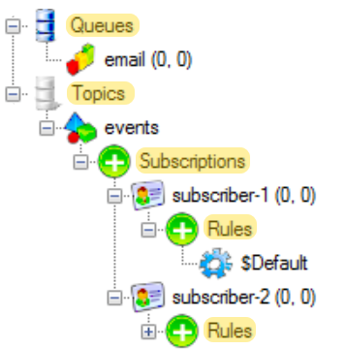
Entities
Notes:
Why do we need messaging? Why can’t we build systems the way those where build in the past?
What’s wrong with layered architecture?
Temporal coupling – RPC / Synchronous communication (calls with assumptions that components are online at the same time)
Spacial coupling – knowing where components are located
Platform coupling – sending binary files vs Text based messages

Slide 15
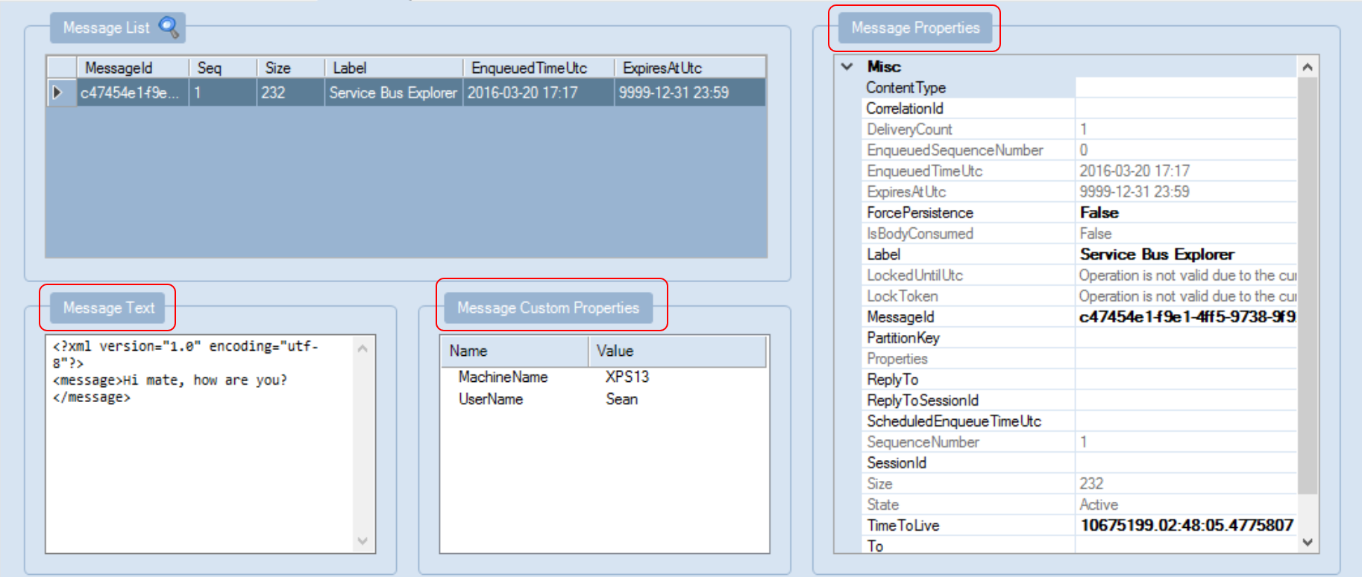
Service Bus Explore

Slide 16

Features

Slide 17
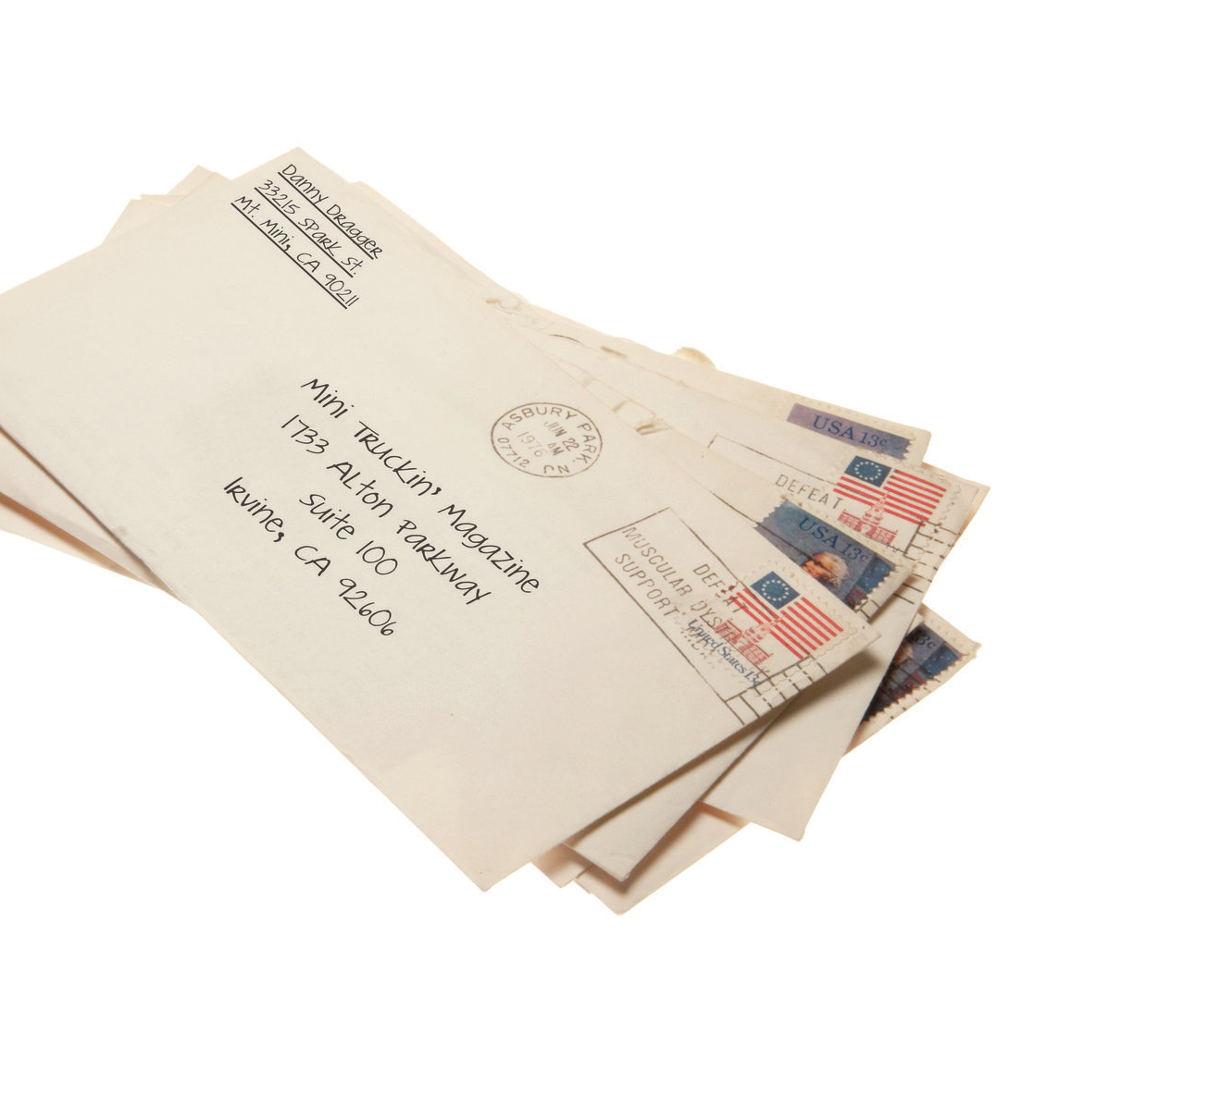
Batching

Slide 18

Deadlettering

Slide 19

Duplicate Detection

Slide 20

Ephemeral Entities

Slide 21

Message Expiration

Slide 22

Scheduling

Slide 23
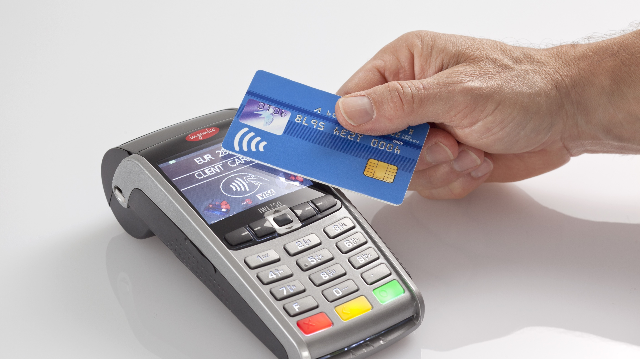
Transactions

Slide 24

Sessions

Slide 25

Auto Forwarding
Notes:
Centralized DLQ
Dynamic property “DeadLetterSource”

Slide 26

Working with Entities
NamespaceManager
QueueDescription
TopicDescription
SubscriptionDescription

Slide 27
Receiving Messages
Receive and Delete
Message received and deleted in one operation (possible message loss) Message can’t be abandoned, deferred, or dead-lettered At-most-once delivery
Peek Lock
Two-phased receive (possible repeated message processing) Message can be abandoned, deferred, or dead lettered Receiver is responsible for completion At-least-once delivery
OnMessage
Multi-threaded message pump with controlled concurrency Messages can be auto-completed or completed manually Auto renewal of timeouts

Slide 28
BrokeredMessage & Client Types
BrokeredMessage
QueueClient
TopicClient
SubscriptionClient
MessageSender
MessageReceiver
MessageSender
MessageReceiver
QueueClient
QueueClient
Brokered
Message
TopicClient
SubscriptionClient

Slide 29
Operations in PeekLock Mode
Receive
Complete
Abandon
Defer
Deadletter
Lock timeout expired X MaxDeliveryCout
Message marked as completed and removed from the queue.
Message becomes visible on the queue and can be received again.
Message remains on the queue and will be received later.
Message is moved to deadletter sub-queue and can be received from that queue.
Message is moved to deadletter sub-queue and can be received from that queue.
Notes:
RetryPolicy
exception.IsTransient

Slide 30
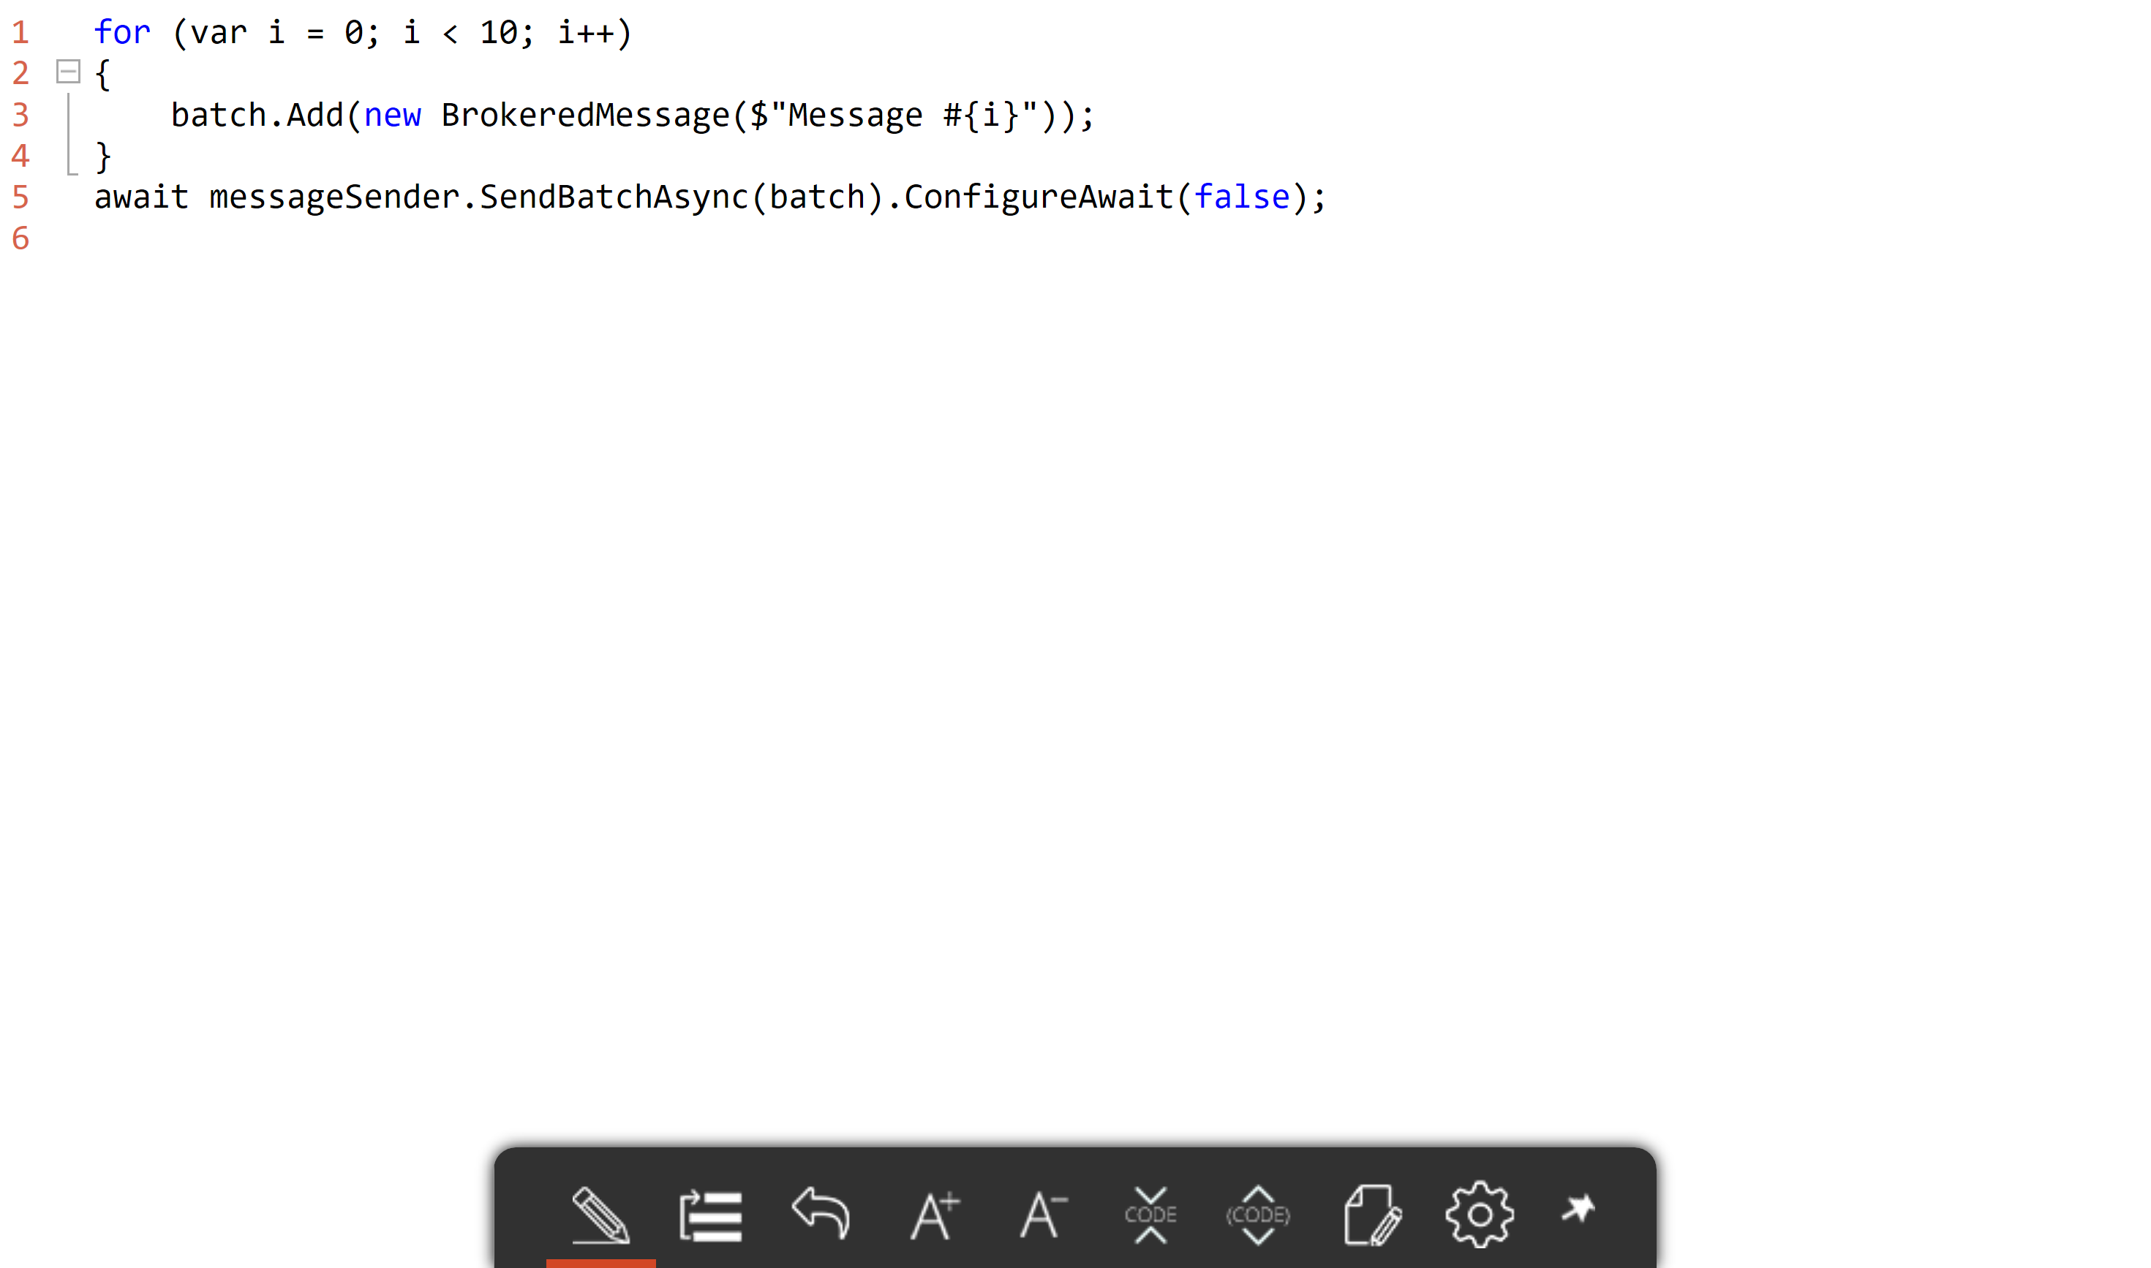
Batching

Slide 31
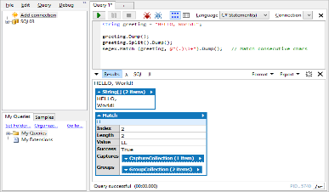
OnMessage API
Process
Complete Abandon Defer Deadletter
OnMessageOptions (AutoComplete , AutoRenewTimeout, MaxConcurrentCalls)
OnMessageOptions.ExceptionReceived
MessageReceivier/client.OnMessageAsync
Demo

Slide 32
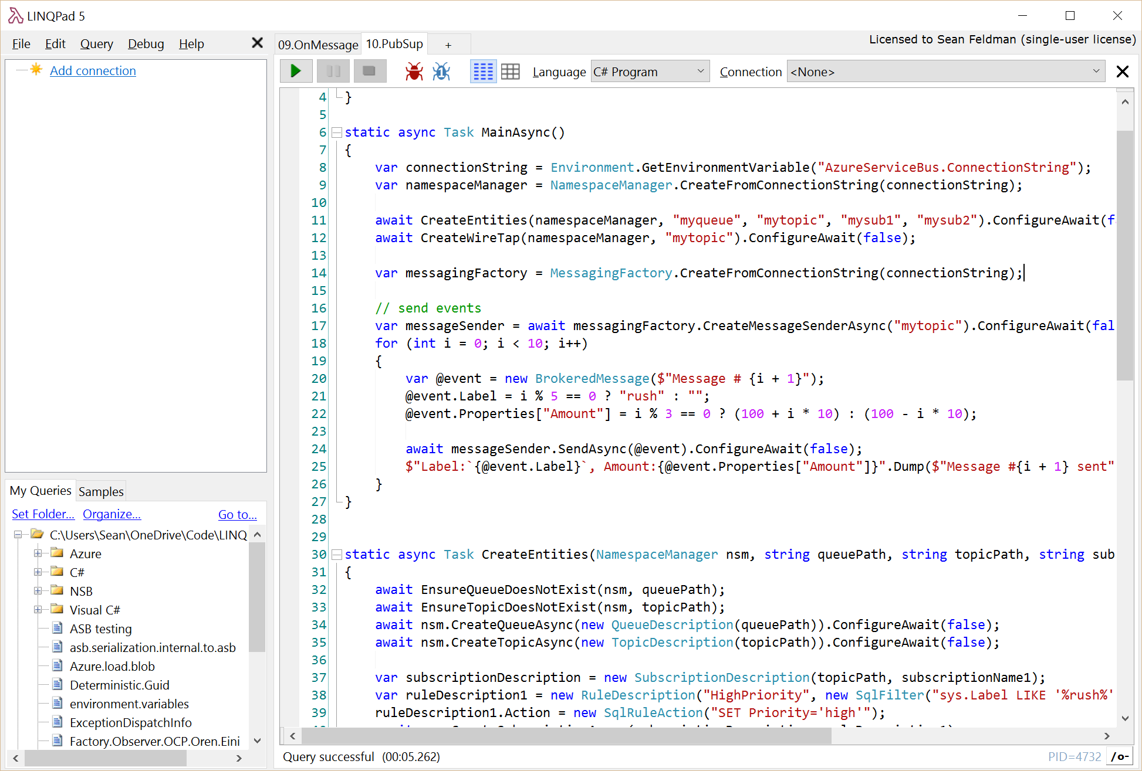
Pub/Sub
Topic: mytopic
Subscription: mysub1
sys.Label LIKE ‘%rush%’ OR Amount >= 100
Rules
Filter
HighPriority
SET Priority=‘high’
Action
Subscription: mysub1
Rules
(Amount < 100) AND (sys.Label NOT LIKE '%rush%')
Filter
NormalPriority
Action
SET Priority=‘normal’
Demo

Slide 33
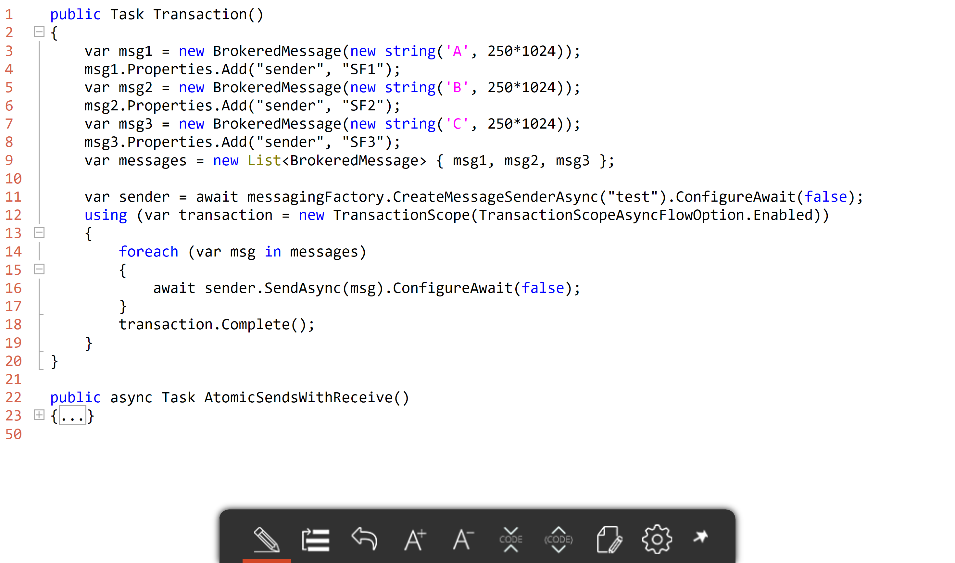
Transactions

Slide 34
Forwarding
Centralized DLQ sample
Dynamic property “DeadLetterSource”

Slide 35
Exception Handling
RetryPolicy
exception.IsTransient

Slide 36



Why Azure Service Bus?

Slide 37


Work Smart NServiceBus

Slide 38

Thank you!
Slides & code https://github.com/SeanFeldman/ASB-SingaporeMicrosoft
Connect @sfeldman
Send your feedback to feldman.sean@gmail.com
Feel up your RSS feed with https://weblogs.asp.net/sfeldman
Tools
Service Bus Explorer https://github.com/paolosalvatori/ServiceBusExplorer
LinqPad https://www.linqpad.net/

